Slide 1
Business analytics
Session 5

Slide 2
Week 5
Artificial Intelligence
Prescriptive Analytics
Predictive Analytics
Optimization (II, III)
Risk modeling (IV, V)
Value
Diagnostic Analytics
Forecasting (I)
Simulation (V, VI)
Descriptive Analytics
Extract, Transform, Load
Difficulty
Notes:
Simulation is more versatile and can be used for both predictive and prescriptive

Slide 3
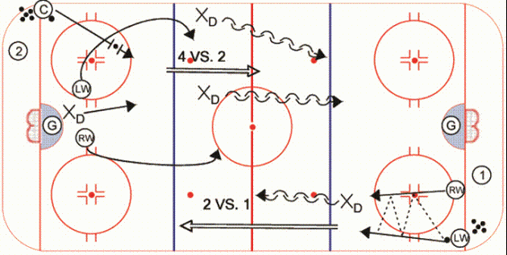
Game plan
ADVANCED RISK MODELING (HEALTHCARE)
INTRO TO SIMULATION
SIMULATION Practice problems

Slide 4
Game plan
ADVANCED RISK MODELING (HEALTHCARE)
INTRO TO SIMULATION
SIMULATION Practice problems

Slide 5

Healthcare and Risk Modeling
Company X is implementing a new policy for vaccinating its employees against a novel infectious disease.
Under this policy all employees who do not have immunity (through past vaccination or past infection) must be vaccinated once a year. Specifically, each year, the company must choose one of two types of single-shot vaccines. The cost of type A vaccine is 100 dollars per year per person and the cost of the type B vaccine is 200 dollars per year per person.
For each employee, the probability that the vaccination is successful (i.e. that the vaccinated employee develops immunity) in a given year is 50% under the type A vaccine and 80% under the type B vaccine. A successful vaccination results in lifelong immunity.
If vaccination fails, the risk of contracting the disease is 20% in that year. Each infection results in lifelong immunity (100% survival rate). The infection is not lethal, but it requires a treatment that costs $1000.

Slide 6
Healthcare and Risk Modeling
Suppose you are a health insurance company paying for all medical expenses of Company X. You want to minimize total costs. Use a decision tree to represent and solve the problem of determining the minimum expected cost vaccination plan for an employee with a one-year contract.
What is the minimum expected cost vaccination plan for an employee with a two-year contract?
If there are 100 employees with a one-year contract and 100 employees with a two-year contract, what is the minimum expected total cost of vaccinating all 200 employees?
Suppose now that you are Company X. If you are now told by the insurance company that you may use up to 102% of the cost computed in part c) what will be your recommendation? Your answer should include justification for the objective function it would optimize.

Slide 7
Healthcare and Risk Modeling: Answer a)
Success (0.5)
E[C] = 0.5*100 + 0.5*0.2*1100 + 0.5*0.8*100 = 200
E[C] = 100
Contracted infection?
E[C] = 100
Vaccine A
No (0.8)
Fail (0.5)
E[C] = min (200,240)=200 → Answer: A
Yes (0.2)
E[C] = 100 + 1000
Success (0.8)
E[C] = 200
Contracted infection?
E[C] = 200
Vaccine B
No (0.8)
Fail (0.2)
E[C] = 0.8*200 + 0.2*0.2*1200 + 0.2*0.8*200 = 240
Yes (0.2)
E[C] = 200 + 1000

Slide 8
Healthcare and Risk Modeling: Answer b)
Success (0.5)
E[TC] = 100*0.5 + 1100*0.2* 0.5
+ 300*0.8* 0.5 = 280
E[TC] = 100
A
E[TC] = 300 (See part a)
E[TC] = min (300, 340) = 300
Contracted infection?
No (0.8)
B
Vaccine A
E[TC] = 340 (See part a)
Fail (0.5)
Yes (0.2)
E[TC] = min (280,272)=272 → Answer: year 1: B, Year 2: A
E[TC] = 1100
Success (0.8)
E[TC] = 200
A
Vaccine B
E[TC] = 400 (See part a)
E[TC] =min (400,440) = 400
Contracted infection?
B
No (0.8)
E[TC] = 200*0.8 + 1200 *0.2 * 0.2 + 400 *0.2 * 0.8 = 272
Fail (0.2)
E[TC] = 440 (See part a)
Yes (0.2)
E[TC] = 1200

Slide 9
Healthcare and Risk Modeling: c), d)
If there are 100 employees with a one-year contract and 100 employees with a two-year contract, what is the minimum expected total cost of vaccinating all 200 employees?
If you are now told that you may use up to 102% of the cost you computed in part c) what will be your recommendation? How would that affect the number of people vaccinated with vaccine A vs B? How many cases of the disease does this prevent? Your answer should include justification for the objective function it would optimize.

Slide 10
Healthcare and Risk Modeling: Answer c), d)
If there are 100 employees with a one-year contract and 100 employees with a two-year contract, what is the minimum expected total cost of vaccinating all 200 employees?
100*$200 + 100*$272 = $47200
If you are now told that you may use up to 102% of the cost you computed in part c) what will be your recommendation? How would that affect the number of people vaccinated with vaccine A vs B? How many cases of the disease does this prevent? Your answer should include justification for the objective function it would optimize.
The objective function becomes to reduce number of infections as fast as possible (first in year 1, then in year 2). Cost (budget) becomes a constraint.
We are already vaccinating everyone with the more effective vaccine in year 1. Hence, the change will affect only year 2. We can calculate how many more infections can be prevented compared to scenario in c):
$47200 * 0.02 = $944 → can vaccinate $944/40=23.6 additional people in year 2 with vaccine B reducing infections by 23.6*(0.8-0.5)*0.2 = 1.4 people compared to c).

Slide 11
Game plan
ADVANCED RISK MODELING (HEALTHCARE)
INTRO TO SIMULATION
SIMULATION Practice problems

Slide 12

Modeling Risk and Uncertainty
Can you quantify risks/probabilities?
No
Use decision rules
No
Is the system “messy”?
(e.g. many, interacting sources of randomness)
Use decision trees and/or expected value analysis
Yes
Yes
Use simulation modeling

Slide 13
Discrete vs continuous distributions

Slide 14
Ex 1.: Generating discrete random variables
The first step of any simulation is to generate random numbers
For example, in Excel RANDBETWEEN (X,Y) generates discrete uniform random numbers between X and Y
→ Each number between X and Y is equally likely, including X and Y
For example, RANDBETWEEN (1,6) is the same as throwing a 6-sided die

Slide 15
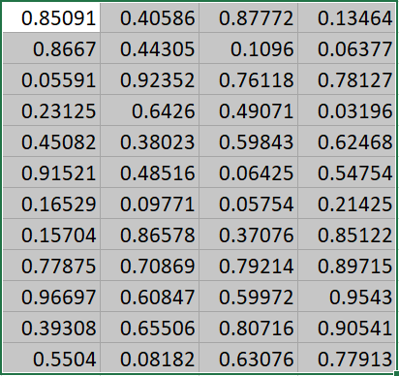
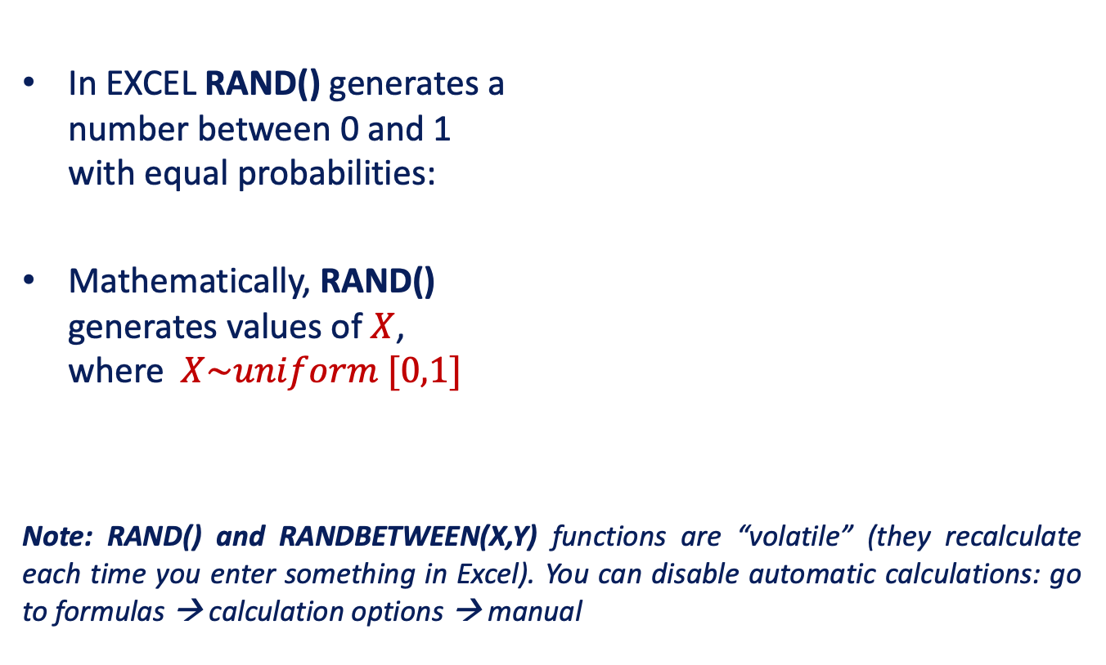
Random Number Generation: Continuous Distributions
In EXCEL RAND() generates a number between 0 and 1 with equal probabilities:
Mathematically, RAND() generates values of $X$, where$X\sim uniform [0,1]$
Note: RAND() and RANDBETWEEN(X,Y) functions are “volatile” (they recalculate each time you enter something in Excel). You can disable automatic calculations: go to formulas → calculation options → manual

Slide 16
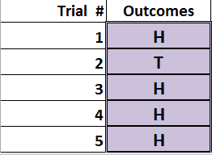
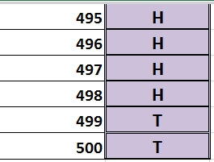
Ex 2.: Generating continuous random variables
Experiment: toss a fair coin 500 times
Event of interest: getting a head “(H)”.
We need to enter formulas in 500 cells to generate values “H” and “T”.

Slide 17
Ex 2.: Generating continuous random variables
Excel procedure:
Enter the following formula: IF(RAND()<0.5, “H”, “T”)
Copy the formula 1000 times
Calculate the number of “H” occurrences
What is the empirical (observed) probability of “H”?

Slide 18
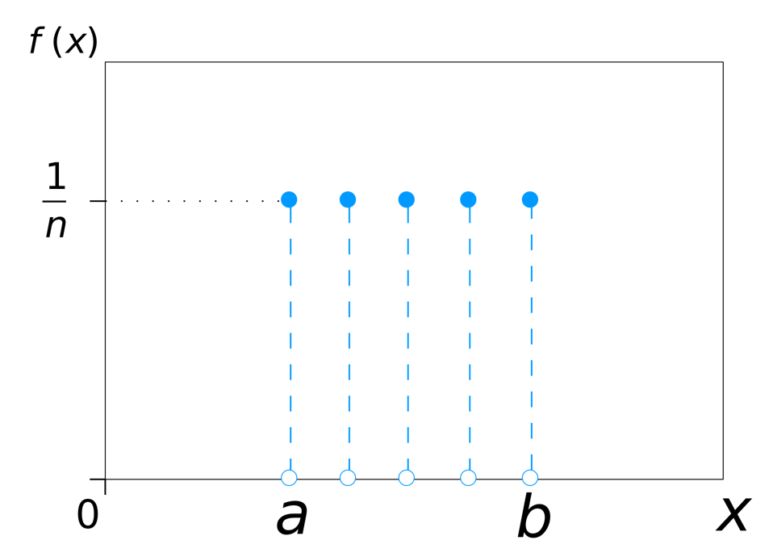
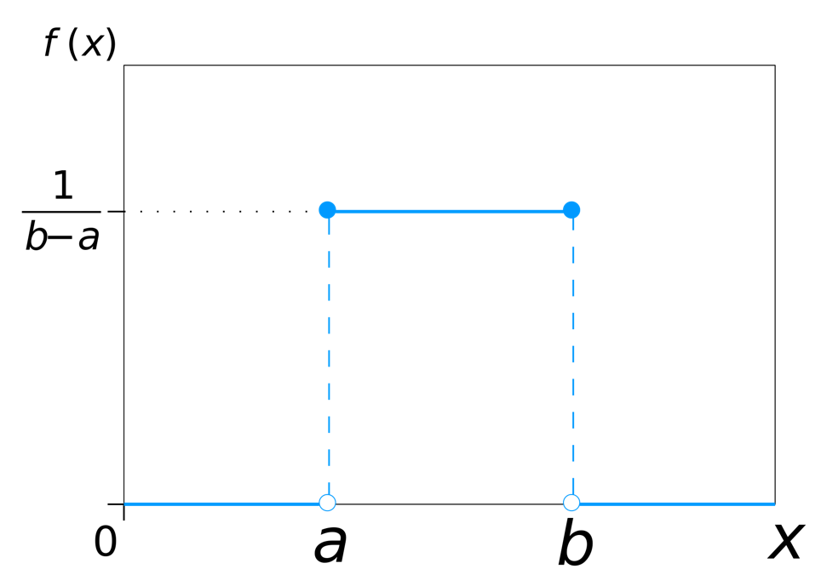
Generating discrete random variables
Discrete uniform: RANDBETWEEN (a,b)
Continuous uniform: RAND() for a=0, b=1
What if different outcomes have different probabilities?

Slide 19
Ex 3.: Generating discrete random variables
For any probability distribution, we can get the cumulative probability
X | 300 | 400 | 500
Prob. (X) | 0.2 | 0.5 | 0.3
Cum prob. F(X) | 0.2 | 0.7 | 1.0
We can then use RAND() to generate a random number between 0 and 1, and then use that number as follows:
If 0.0 ≤ RAND() < 0.2, X = 300.
If 0.2 ≤ RAND() < 0.7, X = 400.
If 0.7 ≤ RAND() < 1.0, X = 500.

Slide 20


Slide 21

Brilliant Color
A classic inventory management problem

Slide 22
Brilliant Color
John Kubick, president of Brilliant Color, normally stocks 100, 200, or 300 cases of BC-6 each week.
For each case that John orders, he pays $25 and for each case that is sold he receives $100 in revenues.
Since each case costs John $25, he loses $25 for every case that is not sold by the end of the week.
Demand for BC-6 is unknown, but based on past data there is a probability of 1/3 of selling 100 cases, a probability of 1/3 of selling 200 cases, and a probability of 1/3 of selling 300 cases.

Slide 23

Brilliant Color
Assume John Kubick is risk-neutral.
Draw a decision tree and determine whether he should stock 100, 200 or 300 cases.

Slide 24
Decision Criteria & Expected Profit
Criterion | Outlook | Description
Maximax Profit | Most Optimistic | Pick alternative with highest highest profit
Maximin Profit | Most Conservative | Pick alternative with highest lowest profit
Minimax Regret | Most Averse to Regret | Pick alternative with lowest highest regret
Max Expected Profit | Risk Neutral | Pick alternative with highest expected profit

Slide 25
Brilliant Color: GAP
Objective:
Decision variables:
Random variables:
Constraints:
Maximize Profit.
Profit = quantity sold * unit revenue –
quantity ordered * unit cost
Quantity ordered
Demand. Can be 100, 200 or 300 with equal probabilities
Note: you cannot sell more than you have ordered or more than demanded →
quantity sold = min{quantity ordered, demand}
Order quantity can be 100, 200 or 300 cases (not 150 or 250 or any other number).

Slide 26
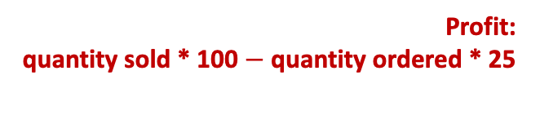
Brilliant Color: Decision Tree Approach
Profit: quantity sold * 100 $−$ quantity ordered * 25
Profit:
Demand = 100
E[Pr.] = 0.33*7.5K + 0.33*7.5K + 0.33*7.5K = 7.5K
100*100-100*25=7.5K
How much to order? Answer: to maximize expected profit, order 300 cases
Demand = 200
100*100-100*25=7.5K
Order 100
Demand = 300
100*100-100*25=7.5K
Demand = 100
100*100-200*25=5K
Order 200
Demand = 200
200*100-200*25=15K
12.5K
E[Pr.] = 0.33*5K + 0.33*15K + 0.33*15K = 11.7K
Demand = 300
200*100-200*25=15K
Order 300
Demand = 100
100*100-300*25=2.5K
max(7.5K, 11.7K, 12.5K)
Demand = 200
200*100-300*25=12.5K
E[Pr.] = 0.33*2.5 + 0.33*12.5K + 0.33*22.5K = 12.5K
Demand = 300
300*100-300*25=22.5K

Slide 27
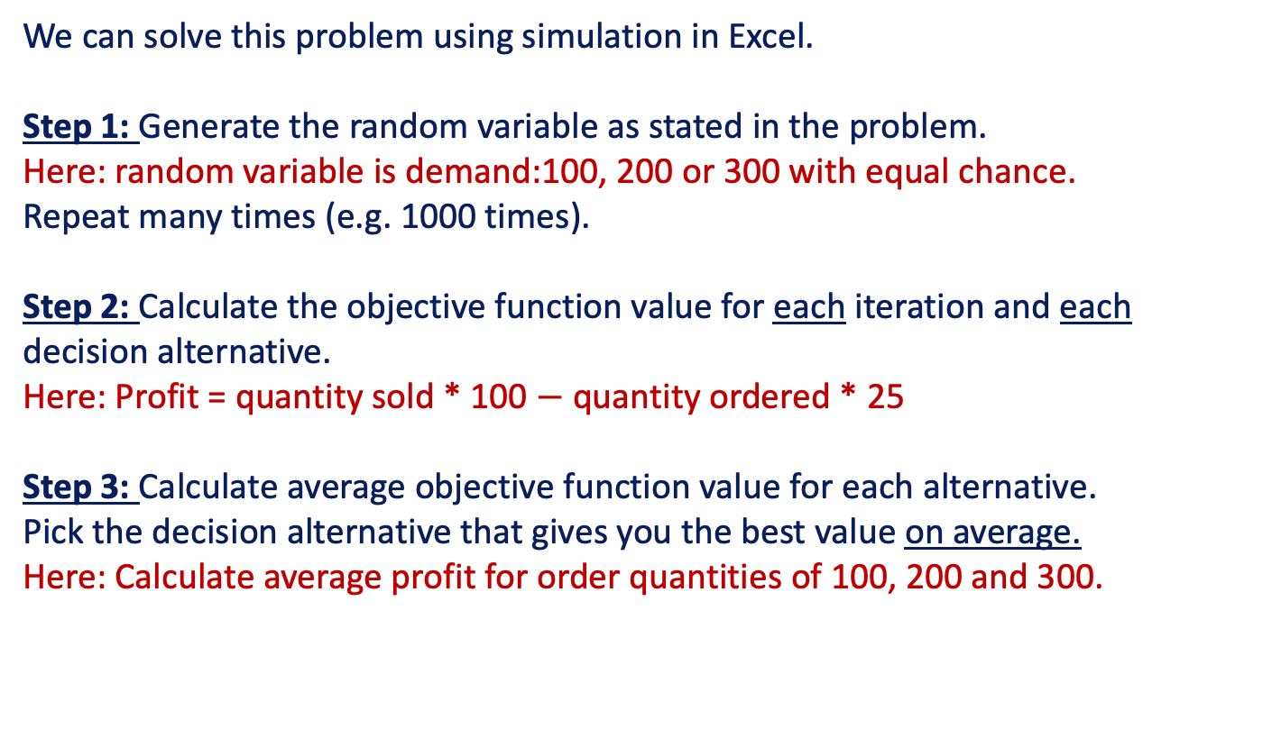
Brilliant Color: Simulation Approach
We can solve this problem using simulation in Excel.
Step 1: Generate the random variable as stated in the problem. Here: random variable is demand:100, 200 or 300 with equal chance. Repeat many times (e.g. 1000 times).
Step 2: Calculate the objective function value for each iteration and each decision alternative. Here: Profit = quantity sold * 100 $−$ quantity ordered * 25
Step 3: Calculate average objective function value for each alternative. Pick the decision alternative that gives you the best value on average.
Here: Calculate average profit for order quantities of 100, 200 and 300.

Slide 28
https://www.dropbox.com/s/zdd1yww9n49wsx7/rain_trimmed.mp4?dl=0
Notes:
https://www.dropbox.com/s/zdd1yww9n49wsx7/rain_trimmed.mp4?dl=0

Slide 29
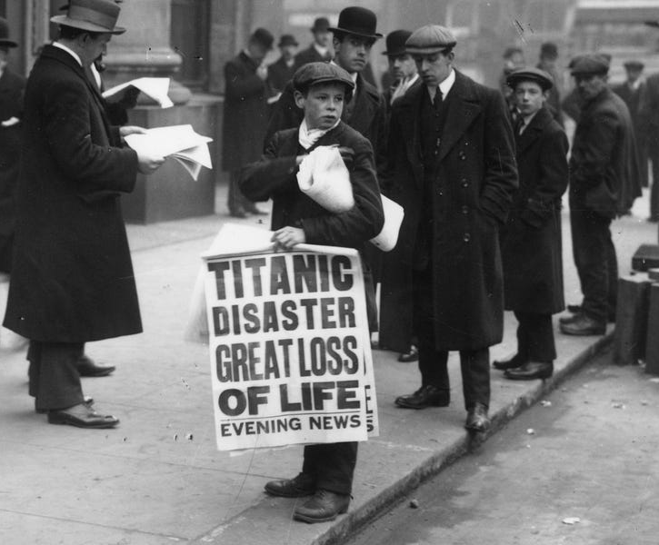
Newsvendor/Newsboy Problem
Given uncertain demand, how much should I order?

Slide 30
Who does the most overbooking?

Slide 31
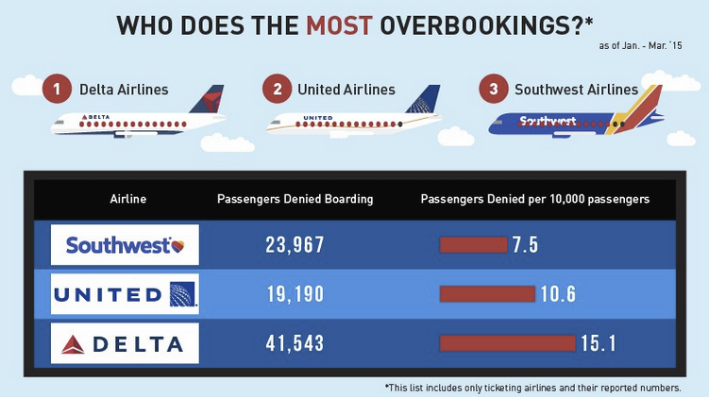
Overbooking

Slide 32
Overbooking example
PROBLEM:
a) Suppose you are UNITED. Flight is sold out, but you can also overbook since some people may not show up.
The revenue from each ticket is $500 (all costs are sunk)
Historical data: number of no-shows is either 1, 2 or 3, with probabilities 30%, 40% and 30%, respectively.
When a customer is denied boarding due to overbooking, you must reimburse their ticket (i.e. pay back $500) and additionally issue them a $250 voucher.
How much do you overbook?

Slide 33
GAP
Define model in words
O: Objective
D: Decision variables
R: What is the source of randomness (risk)?
C: Constraints (not needed here)

Slide 34
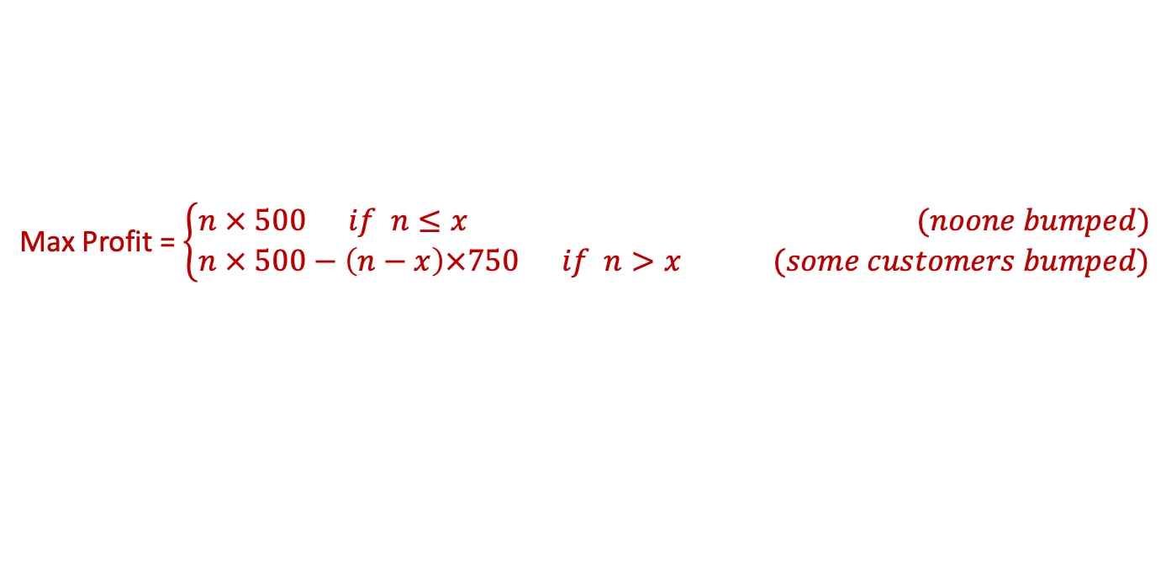
GAP: Overbooking
Define model in words
O: Objective
D: Decision variables
R: What is the source of randomness (risk)?
Formulate model mathematically
D: Define decision variables
R: Define random variables
O: Define objective function in terms of decision variables and random variables
Maximize profit
Number of overbooked seats
Number of no-shows
n = {0,1,2,3} # overbooked seats
x = {1,2,3} # no-shows, w pr. {0.3, 0.4, 0.3}
Max Profit = $\left\{\begin{aligned}n × 500 if n≤x (noone bumped) \\ n × 500−\left(n−x\right)×750 if n>x (some customers bumped)\end{aligned}\right.$

Slide 35
Overbooking: Solution
Profit from overbooking = additional revenue from overbooking $−$cost of vouchers to bumped customers
E[Pr.] = 0.3*500 + 0.4*500 + 0.3*500 = 500
No shows = 1
1*500=500
How much to order? Answer: to maximize expected profit, overbook 2 tickets
No shows = 2
1*500=500
No shows = 3
Overbook 1 seat
1*500=500
No shows = 1
2*500-1*750=250
Overbook 2 seats
No shows = 2
2*500=1000
775
E[Pr.] = 0.3*250 + 0.4*1000 + 0.3*1000 = 775
No shows = 3
2*500=1000
Overbook 3 seats
No shows = 1
3*500-2*750=0
max(500, 775, 250)
No shows = 2
3*500-1*750=750
E[Pr.] = 0.3*0+ 0.4*750 + 0.3*1500 = 750
No shows = 3
3*500=1500

Slide 36

Group Work (15-20 minutes)

Slide 37
Overbooking example
PROBLEM:
b) Your past data reveal that no-shows for this flight range from 0 to 10, with each number being equally likely (I.e. a discrete uniform probability distribution on {0,1,2,3,4,5,6,7,8,9,10}).
How much do you overbook?
Note: we can solve this problem using decision trees/expected value analysis instead of simulation, but it will take more time and effort.

Slide 38
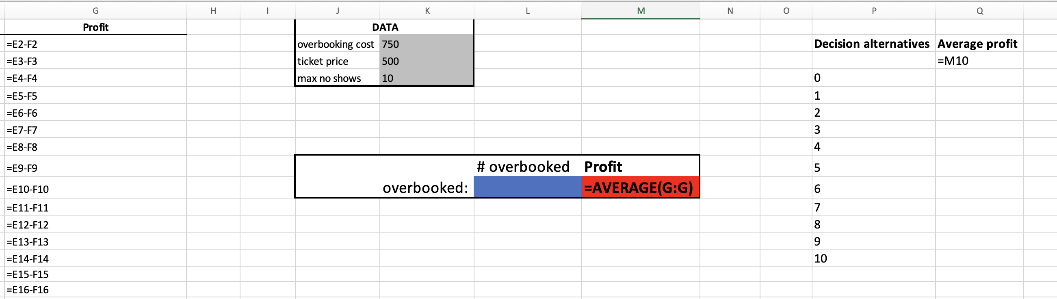
Note on using “Data Table” in Excel
Create an array with two columns: one for decision alternatives and one for profit.
Put the average profit formula (here: M10) at the top of the second column

Slide 39
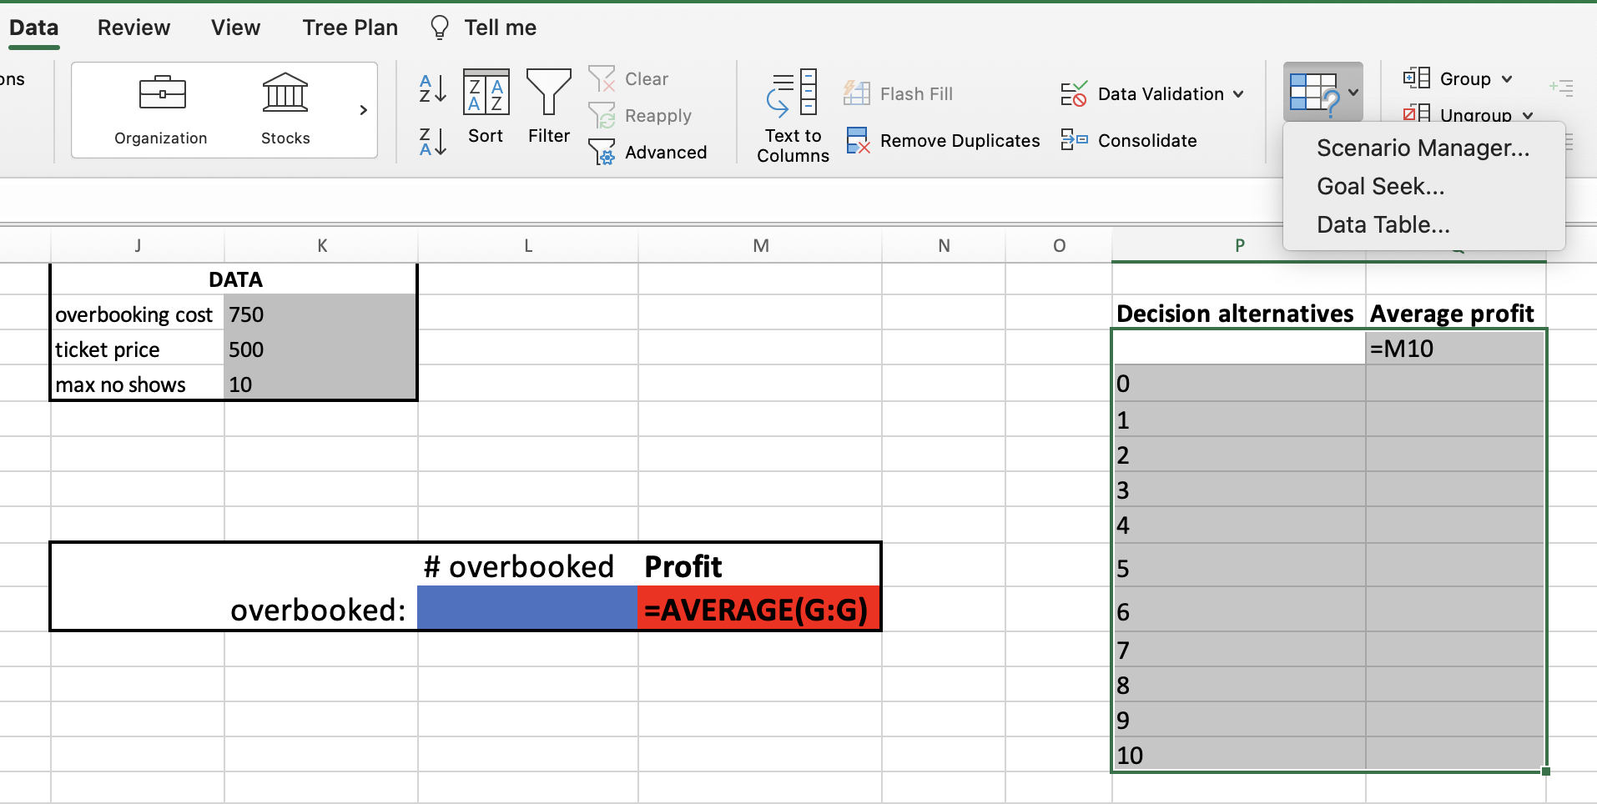
Note on using “Data Table” in Excel
Select the array starting with the empty cell and including both columns
Go to Data → What-if-Analysis → Data Table

Slide 40
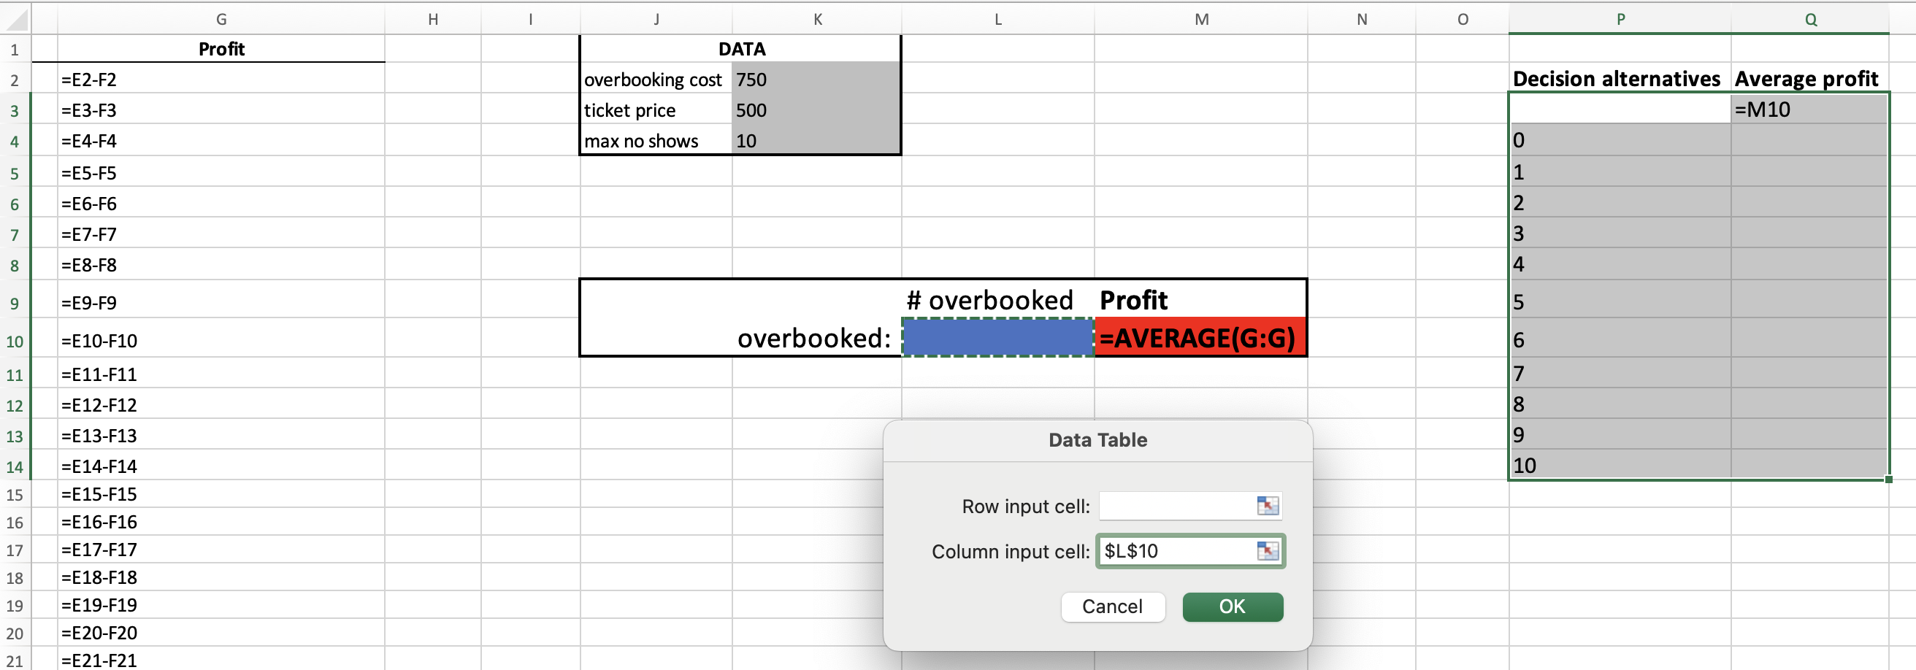
Note on using “Data Table” in Excel
Leave “Row input cell” empty
Enter the decision cell (Here: L10) into “Column input cell”
Hit OK and wait for about 10-20 seconds

Slide 41
Overbooking example
PROBLEM:
c) Your past data reveal that no-shows for this flight range from 1 to 3, with the following distribution:
How much do you overbook?
X = No-shows | 1 | 2 | 3
Prob. (X) | 0.2 | 0.5 | 0.3
Cum prob. F(X) | 0.2 | 0.7 | 1.0

Slide 42
Overbooking example
d) Assume now that each bumped customer tries to negotiate a high voucher value, with the highest voucher value capped at $500. Specifically, assume that the voucher value for each bumped customer is distributed uniformly between $0 and $500 (continuous uniform distribution). How much should you overbook? You can assume the no-show distribution from part c).

Slide 43
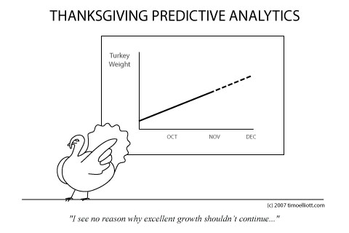
Next Week: No class

Slide 44

To-do’s
HW 5: due in two weeks. Newsvendor example in slides 21-27 of this slide deck should be helpful.
Group projects: Sign up for 10-minute Zoom call with me

